Slide 1



Adding patients A guide to

Slide 2
This presentation will explain how to add patients
We expect that collaborators within each unit will work together to gather the information and input data

Slide 3
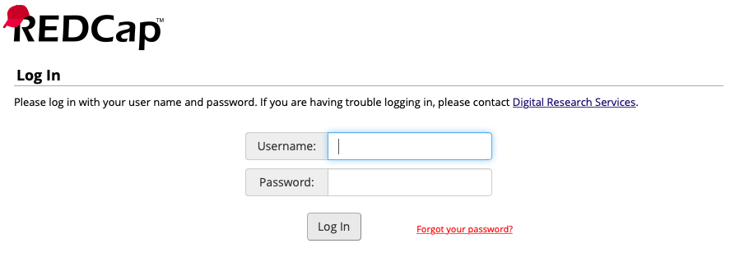
Login to MANTRA at
https://tinyurl.com/y3et96z9

Slide 4
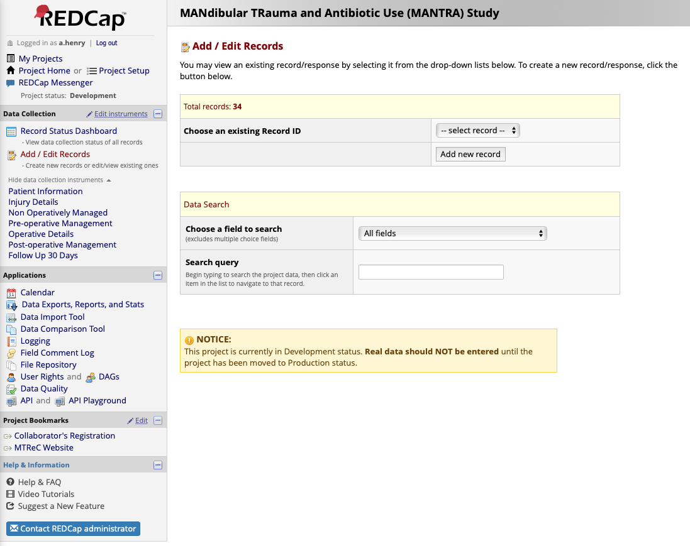
Click add new record

Slide 5
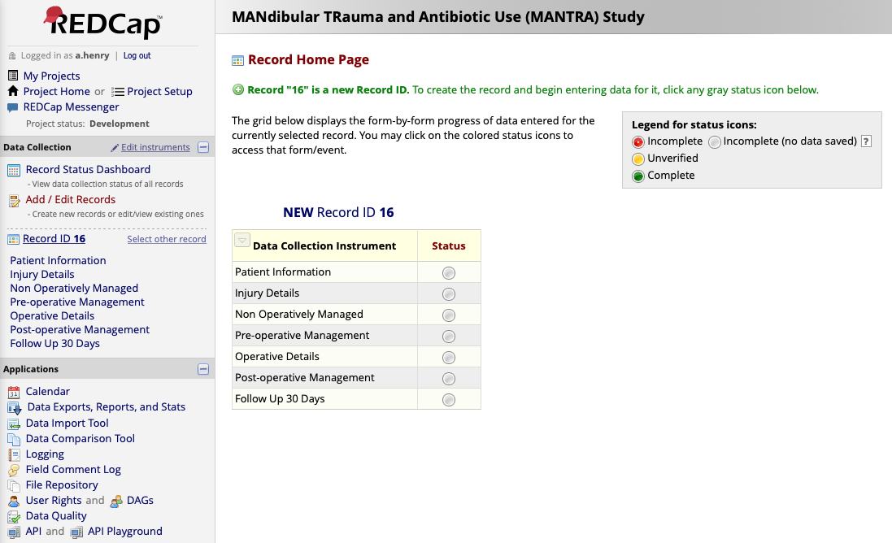
This takes you to the Record ID Page

Slide 6
This takes you to the Record ID Page
Patients will fall into one of two categories; operative or non-operatively managed
The following sections should be completed for each;
Operative | Non-Operatively Managed
Patient information Injury details Pre-operative Management Operative Details Post-operative Management Follow-Up 30 Days | Patient information Injury details Non-Operatively Managed Follow-Up 30 Days

Slide 7
Click the “Patient Information” grey circle to begin entering data

Slide 8
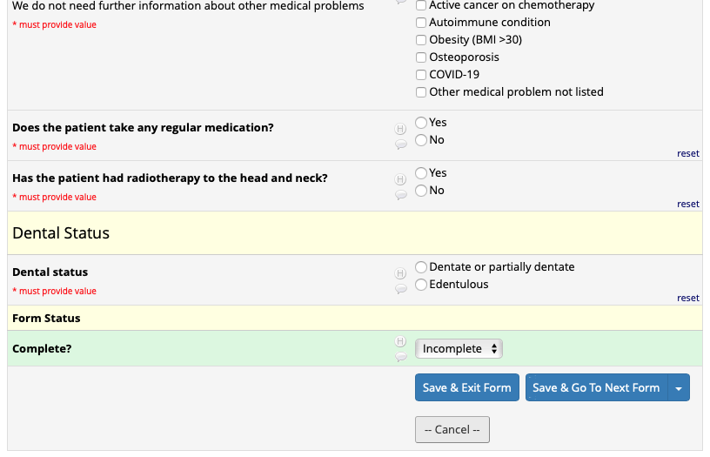
Complete the details then click on “Incomplete”

Slide 9
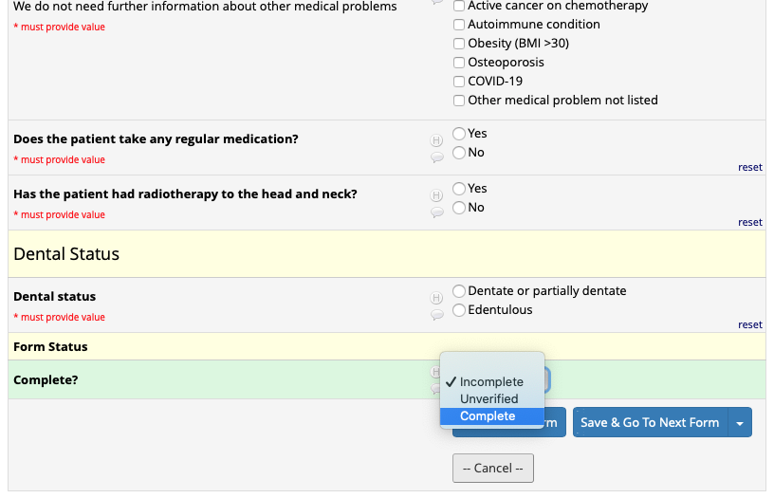
Once complete, select the form status as complete. Then click save and exit form

Slide 10
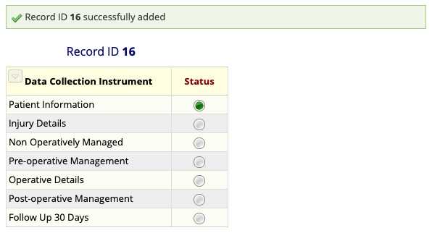
This takes you back to the Record ID. You can then click on the remaining sections

Slide 11
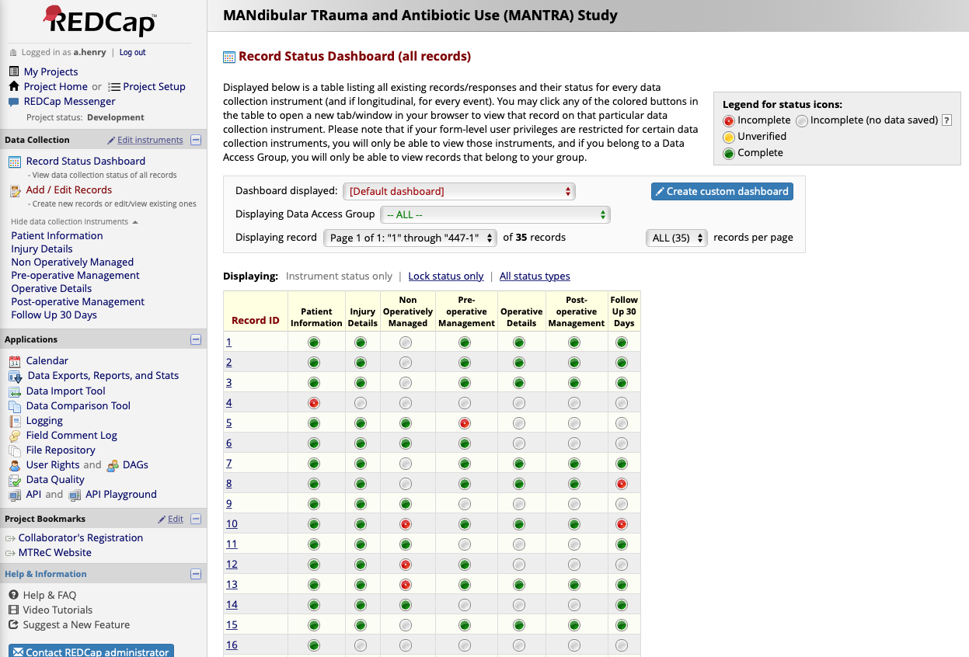
Click ”Record status dashboard” to see and edit the records of all patients

